Slide 1



Self-Service Data Provisioning Through Semantic Enrichment of Data
Ahmad Assaf †
Supervised by:
Aline Senart† and Raphaël Troncy‡
†SAP Research, SAP Research France SAS
‡EURECOM, Sophia Antipolis - France
April 21, 2014
Public

Slide 2
Problem Statement Data Provisioning in the Enterprise
Enterprises use a wide range of heterogeneous information systems in their business activities such as Enterprise Resource Planning (ERP), Customer Relationships Management (CRM) and Supply Chain Management (SCM) systems
From 12 datasets cataloged in 2007, the Linked Open Data has grown to more than 300 datasets
Business Intelligence (BI) has always been about creating new insight for business by converting data into meaning that can be shared between people to drive change in the organization
However, provisioning data for those visualizations is by far the most challenging task in most BI projects large and small
Self Service data provisioning aims at tackling this problem by providing datasets discovery, acquisition and integration techniques intuitively to the end user

Slide 3
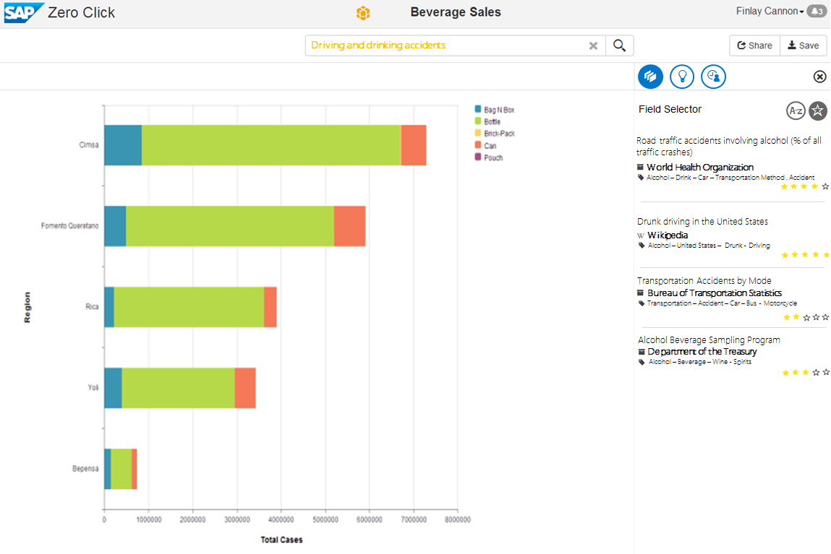

Slide 4
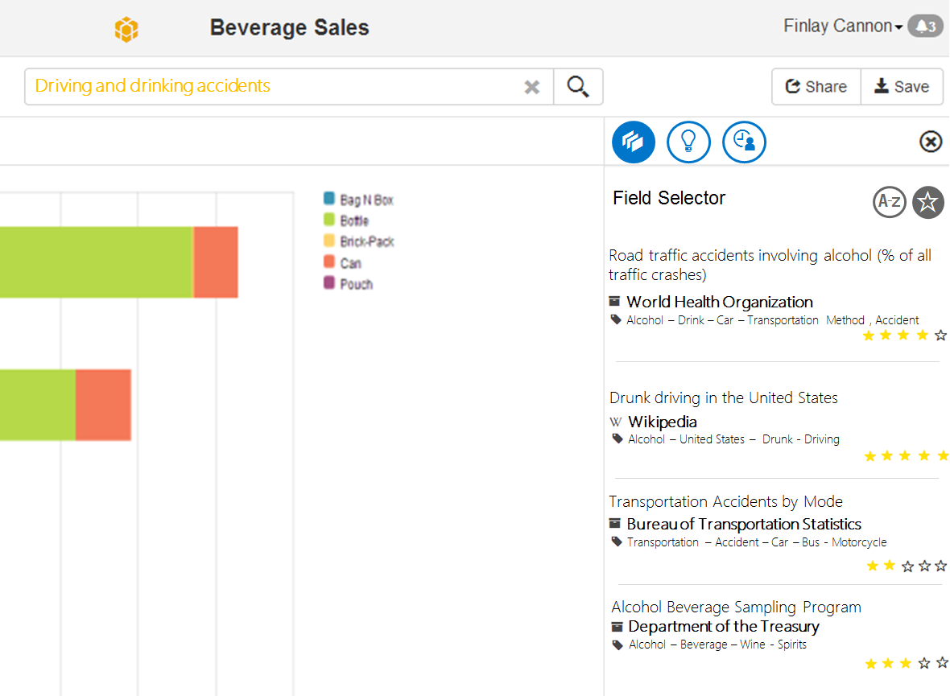
Conclusion

Slide 5
Motivation
We have identified several gaps in the areas of Semantic enrichment, entity and properties ranking and Semantic dataset search
Searching online data portals:
There is a plethora of open online data portals like data.gov, publicdata.eu or private ones like Enigma or Quandl that provide search interfaces on top of their data repository
Open portals data quality depends on the quality of the raw data supplied by the publisher, whereas private portals manually curate and annotate their data
Self-service Data Provisioning: Several companies like Microsoft integrates data with Power Query from different sources

Slide 6
Proposal Architecture
DCAT Index
Semantic Social News Aggregator
Semantic Enricher
Data Profiler
Data Quality Controller
Contextual Entity Recognizer
Entity properties Ranker
Data Crawler
Open Data
Wikipedia
Web Data
Social Web
Dataset Integration and Enrichment
Dataset Discovery
Dataset Quality Control
Notes:
Dataset Integration and Enrichment: large-scale Data Integration requires techniques that can automatically annotate datasets with rich semantic tags. This includes:
Finding the most relevant entity type for an instance within a given context
Finding the top properties of an entity
Identifying relevant data in Social Networks in a timely manner
Dataset Discovery: even though popular datasets like DBpedia and Freebase are well-known and widely used there are other “hidden” useful datasets that are difficult to find
Dataset Quality Control: Linked Data is a new type of structured information supported by models, ontologies and vocabularies and contains query endpoints and links. This makes data quality assurance a challenge

Slide 7
Proposal Dataset Integration and Enrichment
DCAT Index
Semantic Social News Aggregator
Semantic Enricher
Data Profiler
Data Quality Controller
Contextual Entity Recognizer
Entity properties Ranker
Data Crawler
Open Data
Wikipedia
Web Data
Social Web
Dataset Integration and Enrichment
Dataset Discovery
Dataset Quality Control

Slide 8
Proposal Dataset Integration and Enrichment – Contextual Entity Recognizer
Publicly available endpoints of Knowledge Bases have several limitations e.g. servers downtime, API limit throttling, etc.
We imported DBpedia into SAP HANA and provided a Search API
The Contextual Entity Recognizer is able to identify the most relevant type of an entity taking into account contextual information i.e. When disambiguating entities in tabular data at the cellular level, other cells in the same column represents related context
The confidence score is calculated by combining the result from HANA built-in fuzzy text search with an indicator of the entity’s popularity
The popularity is computed by counting the number of incoming and outgoing associations

Slide 9
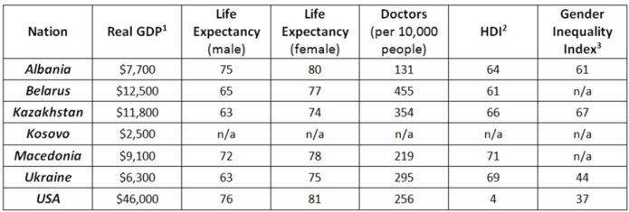
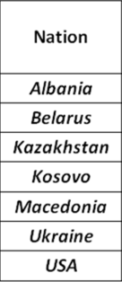
Proposal Dataset Integration and Enrichment – Semantic Enricher
The Semantic Enricher annotates datasets based on the semantics of the data at the instance level
Instead of looking at the table as a set of records with strings, we represent each instance at the cell level with a set of types retrieved from our Contextual Entity Recognizer
The column is represented now as a vector of rich types and their corresponding confidence
By normalizing the confidence scores and aggregating the set of types per column, we select the most common type to annotate and label the column
PL_C
PL_C
PL_C
country:87,3212, music album:12,331,Order of Chivalry:11,2321
……
…….

Slide 10
Proposal Dataset Integration and Enrichment – Semantic Enricher Evaluation
Evaluated against data coming from two SAP systems: The Event Tracker and Travel Expense Manager
Increased the overall confidence score with an average of 11% and the number of valid matches found with an average of 10%
Columns now are labeled with new semantic labels that are unified across datasets with the same content types
Related Publications:
Ahmad Assaf et al. : RUBIX: a framework for improving data integration with linked data. WOD 2012
Ahmad Assaf et al. : Improving Schema Matching with Linked Data.CoRR abs/1205.2691 (2012)

Slide 11
Proposal Dataset Integration and Enrichment – Entity Properties Ranker
It is difficult to assess which properties of an entity are more “important" than others for particular tasks like data augmentation
We performed a reverse engineering of the Google Knowledge Graph Panel to find out what are the most “important" properties for an entity according to Google
We conducted a survey on 152 users which validated the results of our Entity Properties Ranker
We represent the results of our Entity Properties Ranker using the Fresnel vocabulary, so that any application could just use this knowledge to decide which properties of an entity is worth to be augmented with the current data
Related Publications:
Ahmad Assaf et al. : RUBIX: a framework for improving data integration with linked data. WOD 2012
Ahmad Assaf et al. : Improving Schema Matching with Linked Data.CoRR abs/1205.2691 (2012)

Slide 12

Proposal Dataset Integration and Enrichment – Social Media
DCAT Index
Semantic Social News Aggregator
Semantic Enricher
Data Profiler
Data Quality Controller
Contextual Entity Recognizer
Entity properties Ranker
Data Crawler
Open Data
Wikipedia
Web Data
Social Web
Dataset Integration and Enrichment
Dataset Discovery
Dataset Quality Control

Slide 13
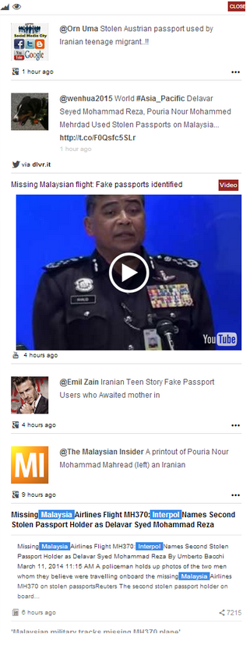

Proposal Dataset Integration and Enrichment – Semantic Social News Aggregator(SNARC)
SNARC is a service that extracts the semantic context of documents in order to recommend related content from the web and social media
SNARC enriches the user experience by allowing the user to get fresh perspective on what is happening as well as knowledge about identified concepts
SNARC provides a uniform semantic document model for web entities, whether they are blog entries, multimedia objects or micro-posts

Slide 14
Proposal Dataset Integration and Enrichment – Semantic Social News Aggregator (SNARC)
SNARC uses services like Zemanta and Alchemy to identify semantic entities in textual content and unifies Social Media content in a Semantic Document Model
SNARC federates queries to various Social Media sources like Twitter, Google+, YouTube, etc.
SNARC reconciles the results fetched to ensure their alignment and relevancy with the underlying model
SNARC has been implemented as a Chrome extension, but we plan to integrate it with business applications
The input for SNARC will be the annotations (entities, topics, categories) attached to data sources
Related Publications:
Ahmad Assaf, Aline Senart, Raphaël Troncy: SNARC - An Approach for Aggregating and Recommending Contextualized Social Content. ESWC (Satellite Events)
Winner of the AI Mash-up Challenge at ESWC13

Slide 15
Proposal Dataset Integration and Enrichment – Statistical Profiler (TBD)
DCAT Index
Semantic Social News Aggregator
Semantic Enricher
Data Profiler
Data Quality Controller
Contextual Entity Recognizer
Entity properties Ranker
Data Crawler
Open Data
Wikipedia
Web Data
Social Web
Dataset Integration and Enrichment
Dataset Discovery
Dataset Quality Control

Slide 16

Proposal Data Quality Control
DCAT Index
Semantic Social News Aggregator
Semantic Enricher
Data Profiler
Data Quality Controller
Contextual Entity Recognizer
Entity properties Ranker
Data Crawler
Open Data
Wikipedia
Web Data
Social Web
Dataset Integration and Enrichment
90%
Dataset Discovery
Dataset Quality Control

Slide 17
Proposal Data Quality Controller – The Problem
Data quality involves data management, modeling, analysis, storage and presentation
It is an important issue for data-driven applications which should be deeply investigated and understood in order to ensure the data is fit to be combined and used to infer better business decisions
Data quality is subjective and cannot be assessed easily, the actual value of data is mainly realized when it is used
Studies found out that most data quality problems are in fact “data misinterpretations” or problems with the data semantics
Openness should be accompanied with a certain level of trust or guarantees about the quality of data
With the rise of Semantic Web, new data quality principles should be identified

Slide 18
Proposal Data Quality Controller– Contribution
We surveyed the landscape of Linked Data quality assessment frameworks
We surveyed the landscape of Linked Data quality assessment tools (25+ different tools)
We suggested an Objective Linked Data Quality Framework that consists of 13 different quality attribute
We have identified a total of 79 quality indicators to measure these abstract attributes

Slide 19
Proposal Data Quality Controller – Contribution
Building on the main four principles for publishing Linked Data, we grouped the quality attributes into four main categories:
Quality of the entities : quality indicators that focus on the data at the instance level (i.e. syntactic checkers)
Quality of the dataset: quality indicators at the dataset level
Quality of the semantic model: quality indicators that focus on the semantic models, vocabularies and ontologies
Quality of the linking process: quality indicators that focus on the inbound and outbound links between datasets

Slide 20
Proposal Data Quality Controller – Contribution
The Linked Data quality tools were grouped to reflect the different aspects of LOD:
Information Modeling Quality
Ontologies and Vocabularies Quality
Dataset Quality
Manual Ranking Tools
Automatic Ranking Tools
Links Based Approach
Provenance-based Approach
Entity-based Approach
Queryable End-point Quality

Slide 21
Proposal Data Quality Controller– Conclusion and Future Work
In the literature survey, we identified several gaps in the current tools landscape
We identified the need for a comprehensive evaluation and assessment framework
We plan to create an extensible component that will span all the identified data quality groups to produce a quality metric
Related Publications:
Ahmad Assaf, Aline Senart: Data Quality Principles in the Semantic Web. ICSC 2012

Slide 22
Conclusion & Future Work
DCAT Index
Semantic Social News Aggregator
Semantic Enricher
Data Profiler
Data Quality Controller
Contextual Entity Recognizer
Entity properties Ranker
Data Crawler
Open Data
Wikipedia
Web Data
Social Web
Dataset Integration and Enrichment
90%
Dataset Discovery
10%
Dataset Quality Control
50%

Slide 23
Thank You!
Contact information:
Ahmad Assaf
www.ahmadassaf.com
@ahmadaassaf
SAP Research, France
Ahmad.assaf@sap.com
+33 695 436 614

Slide 26
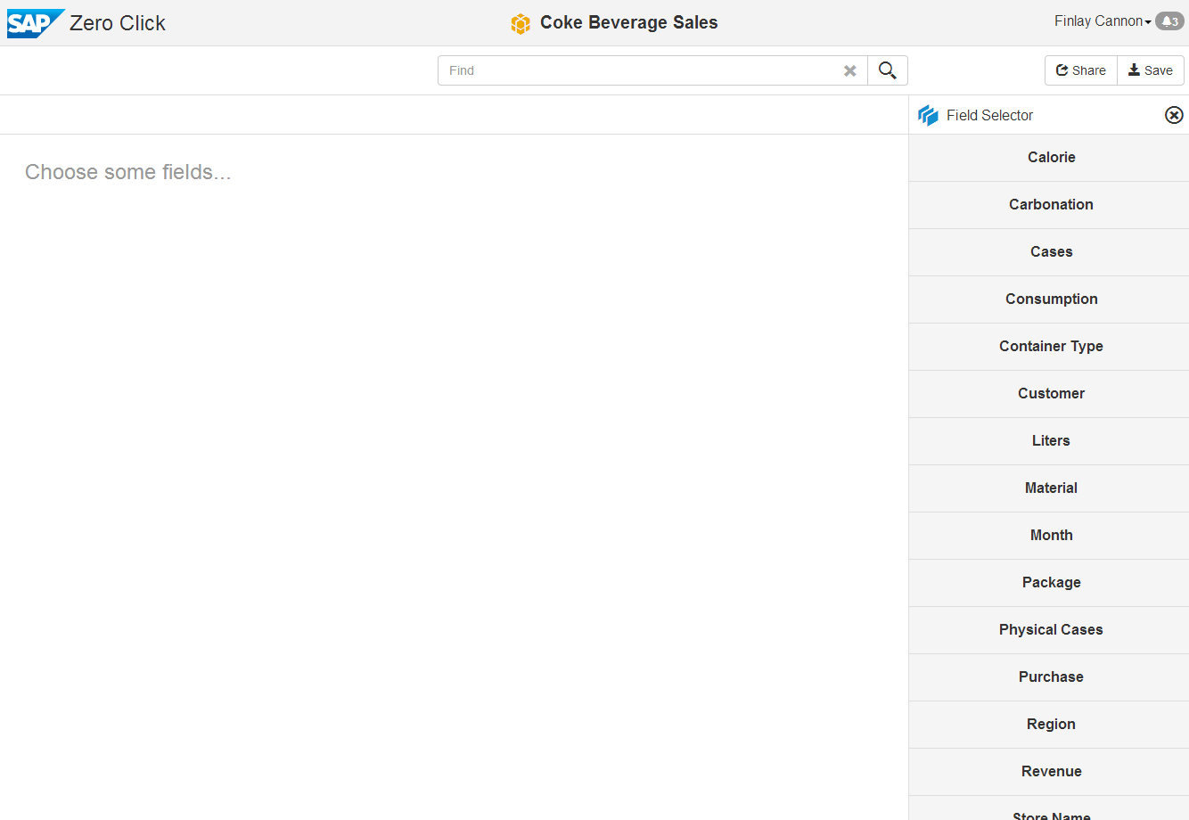
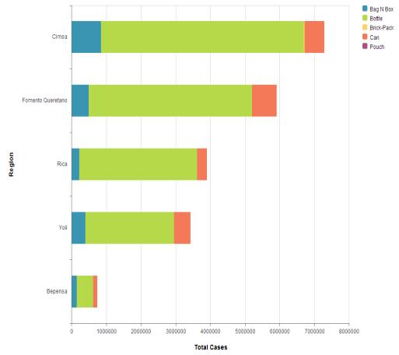
Driving and drinking accidents



Datasets


Road traffic accidents involving alcohol (% of all traffic crashes)
World Health Organization
Alcohol – Drink – Car – Transportation Method , Accident
Drunk driving in the United States
Wikipedia
Alcohol – United States – Drunk - Driving
Transportation Accidents by Mode
Bureau of Transportation Statistics
Transportation – Accident – Car – Bus - Motorcycle
Alcohol Beverage Sampling Program
Department of the Treasury
Alcohol – Beverage – Wine - Spirits

Slide 27

Use Case Business Intelligence Graph (BIG)
The Business Intelligence Graph (BIG) is a set of foundation services for BI applications such as SAP Lumira to facilitate quick and relevant access to analytical content for Decision Makers and Analysts
BIG Harvest BI artefacts, BI usage and user profiles from LDAP directories, online Wikis, communities, etc. and store them in the HANA Graph Engine
In addition to internal enterprise Data Provisioning, data residing in external repositories (data hubs, structured data in web pages, Linked Open Data, etc.) can bring new insights and enhance decision making process

